Slide 1
MARKET FUTURE
Andrea Morelli 1845525
Lorenzo Romagnoli 1975517
Laboratory of advanced programming AY 2021/2022

Slide 2
PROJECT IDEA
The main objective of this project is to develop a distributed web application able to retrieve the financial data of the stocks and from there predict the future trends of those stocks selected by the users other than giving other useful information that could be useful to the user in case of possible financial investment.
Moreover the application helps the user in staying up to date about all the financial and economic news available. Those news are not just presented to the user but, before, they are also checked with a fake detector component in order to verify that there are no patterns in the articles that could be related to fake news.

Slide 3
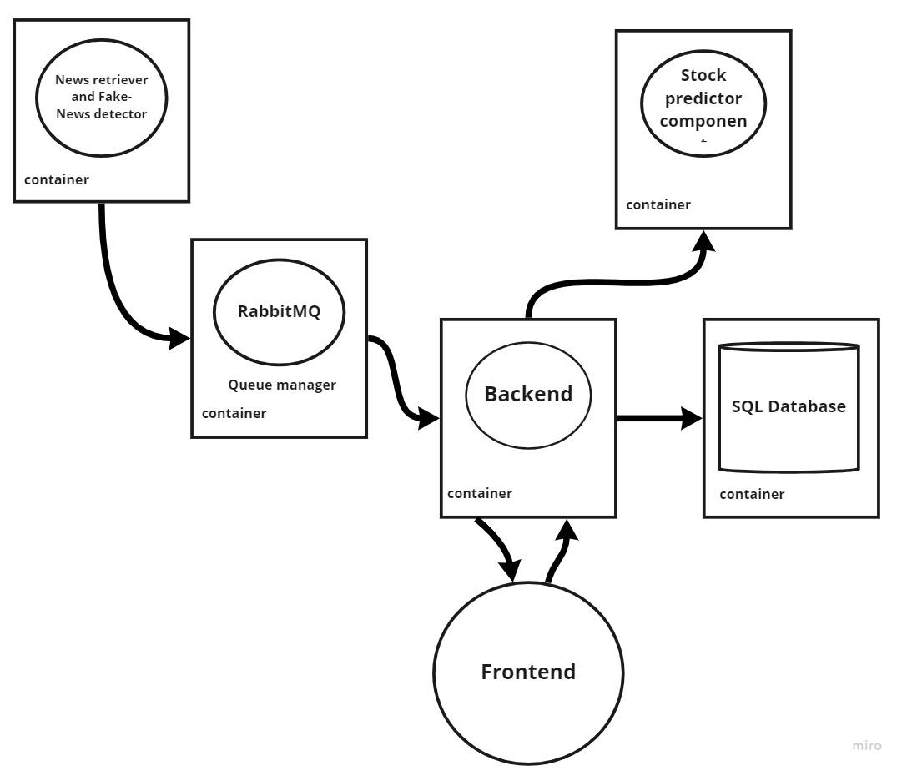
ARCHITECTURE OF THE SYSTEM
Design of the system:
Front-end: login + stocks page + newspage
SQL Based Database.
RabbitMQ
Backend : hosting the RESTful Web application.
News Component
Stock prediction component
external service accessed via api to get the news
external service accessed via api to get the stocks data

Slide 4




OTHER TECHNOLOGIES

Slide 5


SYSTEM ORCHESTRATION

Slide 6
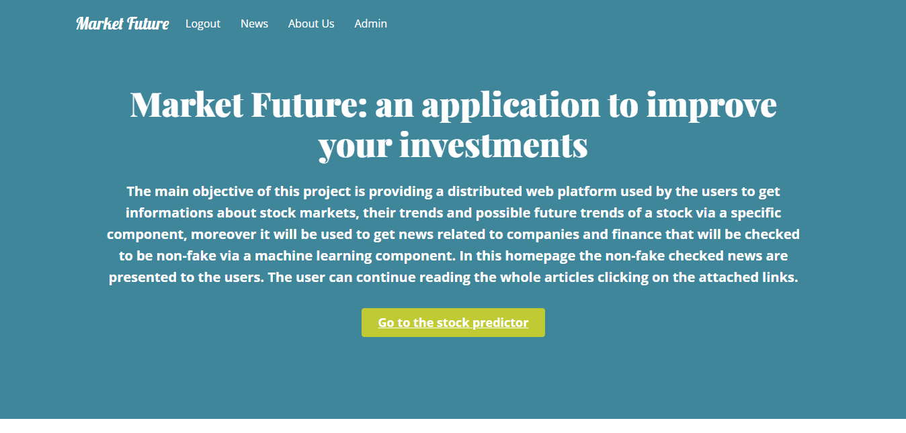
Homepage of the application

Slide 7
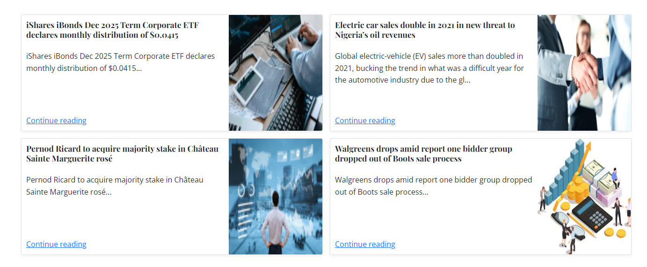
News page

Slide 8



FAKE DETECTOR COMPONENT

Slide 9
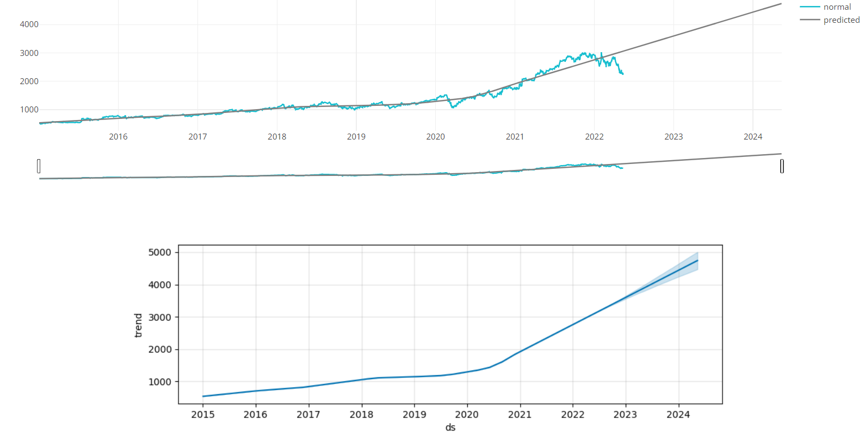
STOCK PREDICTOR PAGE

Slide 10
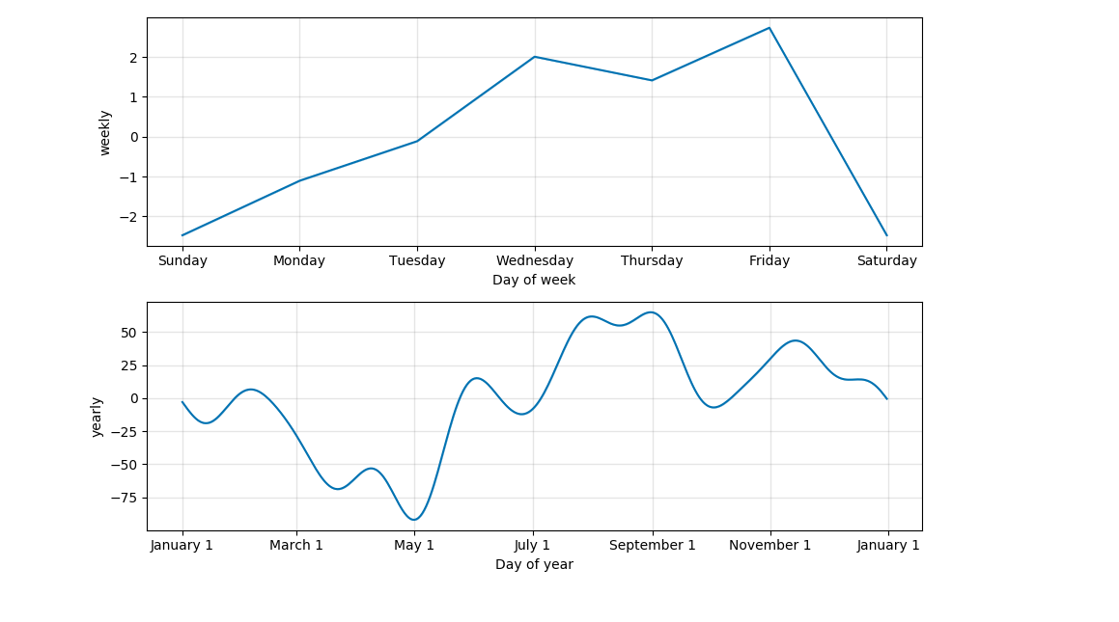
STOCK PREDICTOR PAGE

Slide 11



STOCK PREDICTOR COMPONENT

Slide 12




DEVELOPMENT PROCESS

Slide 13
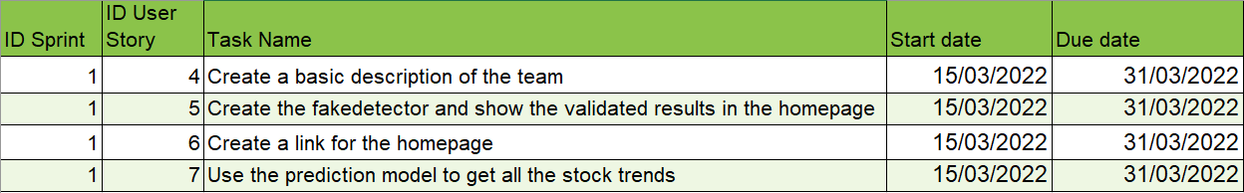
SCRUM DEVELOPMENT : SPRINT 1
The sprints are organized in two weeks each ,for a total of 4 sprints.

Slide 14
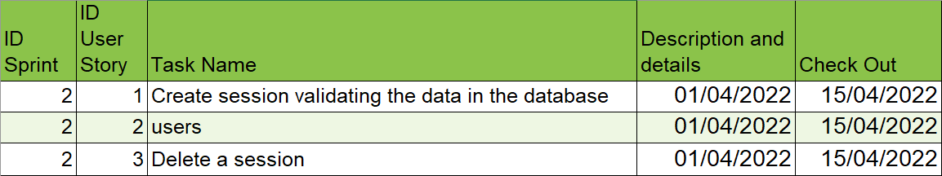
SCRUM DEVELOPMENT : SPRINT 2

Slide 15
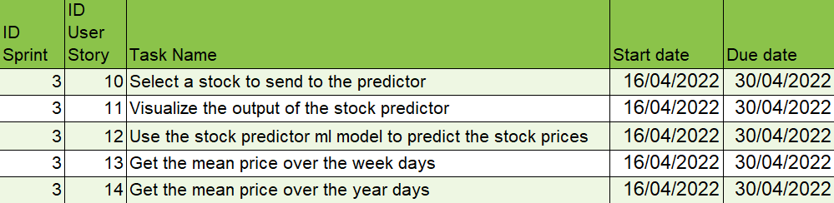
SCRUM DEVELOPMENT : SPRINT 3

Slide 16
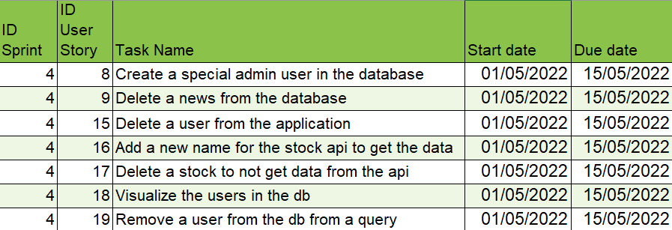
SCRUM DEVELOPMENT : SPRINT 4

Slide 17
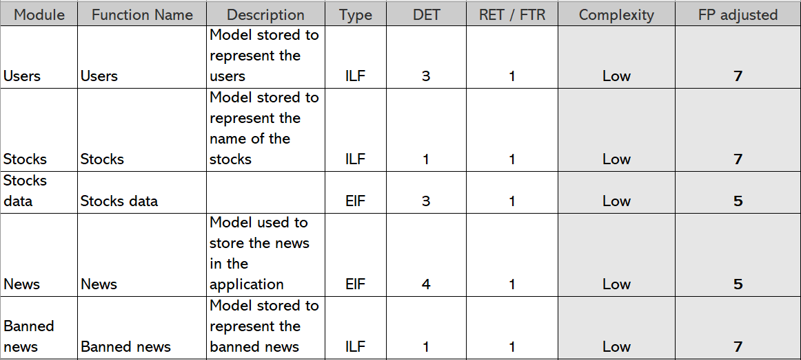
FUNCTION POINTS

Slide 18
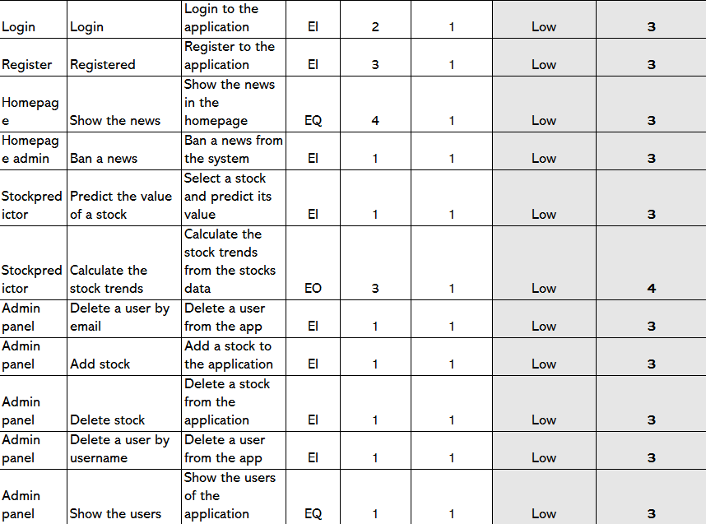
FUNCTION POINTS

Slide 19
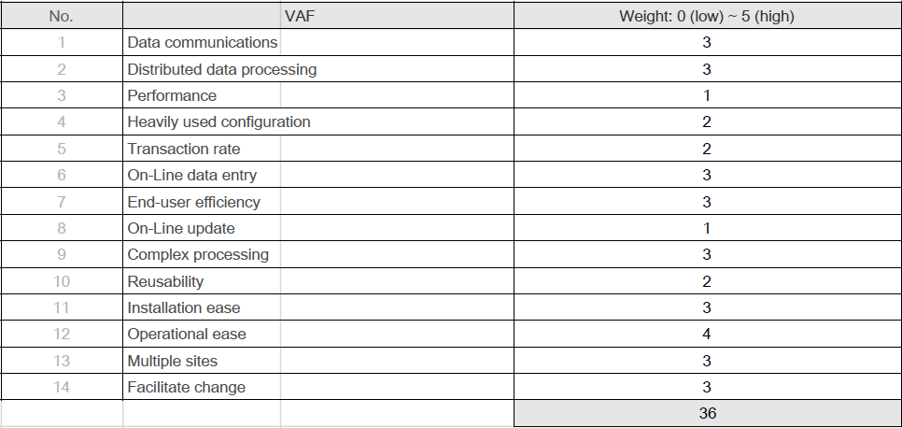
FUNCTION POINTS

Slide 20
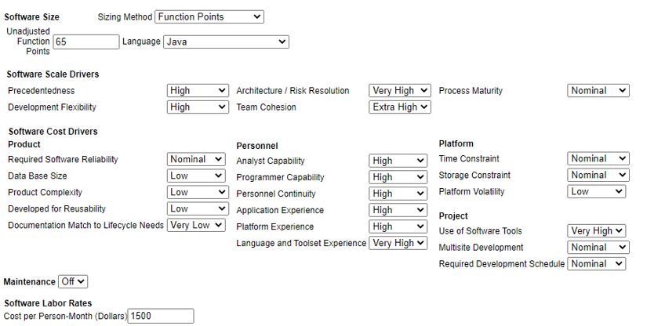
COCOMO 2

Slide 21
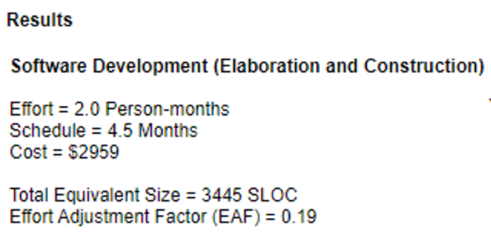
COCOMO” RESULTS
In our application we had instead obtained a total of 2251 SLOC

Slide 22
NOW WE WILL SHOW THE LIVE DEMO OF THE WEB APPLICATION

